Slide 1
Local Hamiltonian Problem with succinct ground state
is MA-complete
Jiaqing Jiang
Caltech CMS & IQIM

Slide 2
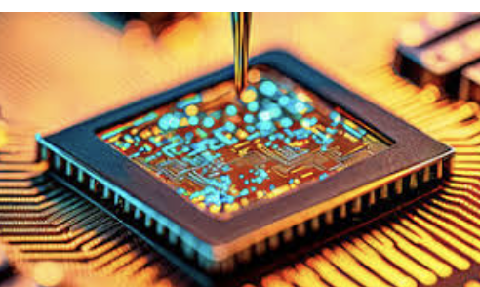
Motivation: Applications of quantum computer?
Quantum for science: Simulate quantum system.
Quantum Chemistry
Condense matter physics
Local Hamiltonian
What and why?
Electronic structure
Chemical Reactions,
Fundamental science…
…
Materials,
Conductor,
Superconductor…

Slide 3
Local Hamiltonian problem: Deciding ground energy of locally interacting many-body systems.

Slide 4
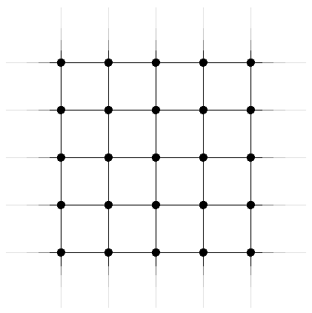
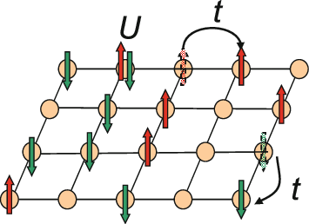
Local Hamiltonian problem: Deciding ground energy of locally interacting many-body systems.
qubit
$$H_{i}$$
Local Hamiltonian $H = H1 + … + Hm$
Estimate the ground energy $λ$(H) within desired precision

Slide 5
Local Hamiltonian problem: Deciding ground energy of locally interacting many-body systems.
qubit
$$H_{i}$$
Local Hamiltonian $H = H1 + … + Hm$
Estimate the ground energy $λ$(H) within desired precision
LHP: Given (H,a,b), Decide λ(H)≤a or λ(H)≥b, b-a>1/poly(n)

Slide 6
How hard is LHP?
LHP: Given (H,a,b), Decide λ(H)≤a or λ(H)≥b, b-a>1/poly(n)
General | Practice
Ground state is a quantum state $2^{n}$ amplitudes.
LHP is QMA-Complete [KKR06].
Quantum analogy of NP.
Intractable for quantum computer.
Heuristic quantum variational method might work for practical case.
NP: problem which can be efficiently verified by classical computer.
QMA: … verified by quantum computer.

Slide 7
Our setting
LHP: Given (H,a,b), Decide λ(H)≤a or λ(H)≥b, b-a>1/poly(n)
General | Practice
Ground state is a quantum state $2^{n}$ amplitudes. | Assume ground state has succinct classical description.
LHP is QMA-Complete [KKR06].
Quantum analogy of NP.
Intractable for quantum computer.
Heuristic quantum variational method might work for practical case.

Slide 8
Our result
LHP: Given (H,a,b), Decide λ(H)≤a or λ(H)≥b, b-a>1/poly(n)
General | Practice
Ground state is a quantum state; $2^{n}$ amplitudes. | Assume ground state has succinct classical description.
LHP is QMA-Complete [KKR06]. | Poly-size classical circuit Matrix product states (DMRG, [Whi92]) Fermionic Gaussian states (Hartree-Fork method [Fis87]) Neural network states [GD17, CTMA19]
Quantum analogy of NP.
Intractable for quantum computer.
Heuristic quantum variational method might work for practical case.

Slide 9
Our result
LHP: Given (H,a,b), Decide λ(H)≤a or λ(H)≥b, b-a>1/poly(n)
General | Practice
Ground state is a quantum state $2^{n}$ amplitutes. | Assume ground state has succinct classical description.
LHP is QMA-Complete [KKR06].
Quantum analogy of NP. | Today’s focus: Complexity Implication of the succinct ground state assumption?
Intractable for quantum computer.
Heuristic quantum variational method might work for practical case.

Slide 10
Our result
LHP: Given (H,a,b), Decide λ(H)≤a or λ(H)≥b, b-a>1/poly(n)
General | Practice
Ground state is a quantum state $2^{n}$ amplitutes. | Assume ground state has succinct classical description.
LHP is QMA-Complete [KKR06]. | NP?? QMA??
Quantum analogy of NP. | Today’s focus: Complexity Implication of the succinct ground state assumption?
Intractable for quantum computer.
Heuristic quantum variational method might work for practical case.

Slide 11
LHP with succinct ground states
H = H₁ + H₂ + … + H_{m}
b-a>1/poly(n)
Yes: $λ$(H)<a, there exists a succinct ground state $ψ$.
No: $λ$(H)>b?
Succinct classical description;
More general than MPS e.t.c
Does not imply sample access
If we wish to prove in NP:
Given a classical circuit for adversarial “ground state” $φ$,
Classically test whether $\left\langle φ\left|H\right|φ\right\rangle <$a or $\left\langle φ\left|H\right|φ\right\rangle$>b?
Only query poly(n) amplitudes!

Slide 12
Our result
LHP: Decide λ(H)≤a or λ(H)≥b, b-a>1/poly(n)
General | Practice
Ground state is a quantum state; $2^{n}$ amplitutes. | Assume ground state has succinct classical description.
LHP is QMA-Complete [KKR06].
Quantum analogy of NP.
Intractable for quantum computer.
Need quantum computer, quantum variational method.

Slide 13
Our result
LHP: Decide λ(H)≤a or λ(H)≥b, b-a>1/poly(n)
General | Practice
Ground state is a quantum state; $2^{n}$ amplitutes. | Assume ground state has succinct classical description.
LHP is QMA-Complete [KKR06]. | Main result: LHP with succinct ground state is MA-Complete.
Quantum analogy of NP. | Randomized analogy of NP.
Intractable for quantum computer.
Need quantum computer, quantum variational method.

Slide 14
Our result
LHP: Decide λ(H)≤a or λ(H)≥b, b-a>1/poly(n)
General | Practice
Ground state is a quantum state; $2^{n}$ amplitutes. | Assume ground state has succinct classical description.
LHP is QMA-Complete [KKR06]. | Main result: LHP with succinct ground state is MA-Complete.
Quantum analogy of NP. | Randomized analogy of NP.
Intractable for quantum computer.
Need quantum computer, quantum variational method.
Reasonable or non-trivial?

Slide 15
Our result
LHP: Decide λ(H)≤a or λ(H)≥b, b-a>1/poly(n)
General | Practice
Ground state is a quantum state; $2^{n}$ amplitutes. | Assume ground state has succinct classical description.
LHP is QMA-Complete [KKR06]. | Main result: LHP with succinct ground state is MA-Complete.
Quantum analogy of NP. | Randomized analogy of NP.
Intractable for quantum computer.
Need quantum computer, quantum variational method.
Reasonable: poly(n) amplitude + randomness is powerful
Non-trivial because of the sign problem
Need special randomized algorithm
Continuous-time Markov Chain

Slide 16
Implication: dequantizing quantum advantage?
Quantum advantage for quantum chemistry but LHP is QMA-Complete
LHP with guided state
Guided states:
1/poly(n) overlap with ground state
Efficiently prepared by quantum circuit.
Quantum Algorithm:
Guided states $⇒$ Efficient quantum algorithm for LHP
Seems hard to dequantize
Potential quantum advantage
Most time guided states are succinct
When can be dequantized?

Slide 17
Implication: dequantizing quantum advantage?
LHP with guided state
“Quantum advantage is achieving better precision”.
For 1/poly precision. [GLG22] [WFC23].
Guided state is given: BQP-Complete
Guided state is as witness: QCMA-Complete
For constant precision
Dequantize to BPP, NP.
Condition on QCMA$≠$ NP, with succinct guided states, quantum algorithm can achieve higher precision!
LHP: Decide λ(H)≤a or λ(H)≥b,
b-a>1/poly(n)

Slide 18
Implication: dequantizing quantum advantage?
LHP with guided state
More questions
“Quantum advantage is achieving better precision”.
For 1/poly precision. [GLG22] [WFC23].
Guided state is given: BQP-Complete
Guided state is as witness: QCMA-Complete
For constant precision
Dequantize to BPP, NP.
Condition on QCMA$≠$ NP, with succinct guided states, quantum algorithm can achieve higher precision!
Where to find guided states?
From existing classical algorithms?
[LLZ+23] Those guided states may be stronger enough to enable a classical algorithm.
Open question: LHP with strong guided states is NP or MA-complete?
variational randomized classical algorithm might work.

Slide 19
Difficulty for dequantizing: Sign Problem Extremely strong guided states → Circumvent the sign problem
Try dequantizing LHP + Guided states
Entry-wise 1/poly overlap with gs
Extremely strong guided states
1/poly(n) precision | Standard guided states | Strong guided states (open problem) | Succinct ground state (Our result)
Stoquastic
General | QCMA-Complete [WFC23] | ??? | ???

Slide 20
Try dequantizing LHP + Guided states
Difficulty for dequantizing: Sign Problem Extremely strong guided states → Circumvent the sign problem
Entry-wise 1/poly overlap with gs
Extremely strong guided states
1/poly(n) precision | Standard guided states | Strong guided states (open problem) | Succinct ground state (Our result)
Stoquastic
General | QCMA-Complete [WFC23] | ??? | ???

Slide 21
Try dequantizing LHP + Guided states
Difficulty for dequantizing: Sign Problem Extremely strong guided states → Circumvent the sign problem
Entry-wise 1/poly overlap with gs
Extremely strong guided states
1/poly(n) precision | Standard guided states | Strong guided states (open problem) | Succinct ground state (Our result)
Stoquastic | ??? | MA-Complete [Bra14] | MA-complete [BT10] [Liu20]
General | QCMA-Complete [WFC23] | ??? | ???
Can we circumvent
sign problem?

Slide 22
Try dequantizing LHP + Guided states
Difficulty for dequantizing: Sign Problem Extremely strong guided states → Circumvent the sign problem
Entry-wise 1/poly overlap with gs
Extremely strong guided states
1/poly(n) precision | Standard guided states | Strong guided states (open problem) | Succinct ground state (Our result)
Stoquastic | ??? | MA-Complete [Bra14] | MA-complete [BT10] [Liu20]
General | QCMA-Complete [WFC23] | ??? | Our results: MA-Complete
Can we circumvent
sign problem?
Yes! We can

Slide 23
Try dequantizing LHP + Guided states
Difficulty for dequantizing: Sign Problem Extremely strong guided states → Circumvent the sign problem
Entry-wise 1/poly overlap with gs
Extremely strong guided states
1/poly(n) precision | Standard guided states | Strong guided states (open problem) | Succinct ground state (Our result)
Stoquastic | ??? | MA-Complete [Bra14] | MA-complete [BT10] [Liu20]
General | QCMA-Complete [WFC23] | Open problem | Our results: MA-Complete
Can we circumvent
sign problem?
Magical Continuous-time MC?

Slide 24
Proof Sketch

Slide 25
Simplification
LHP with succinct ground states
H = H₁ + H₂ + … + H_{m}
Yes: $λ$(H)=0, there exists a succinct ground state $ψ$.
No: $λ$(H)>1/poly(n)?
Further assume H, $ψ$ are real-valued.
Main result: LHP with succinct ground state is in MA.
Given query access to $φ$. For simplicity, assume ${\left|φ\right|}^{2}=1$.
Test H$φ$=0 or $\left\langle φ\left|H\right|φ\right\rangle$>1/poly(n) using randomized classical algorithm.
$φ$ can be adversary

Slide 26
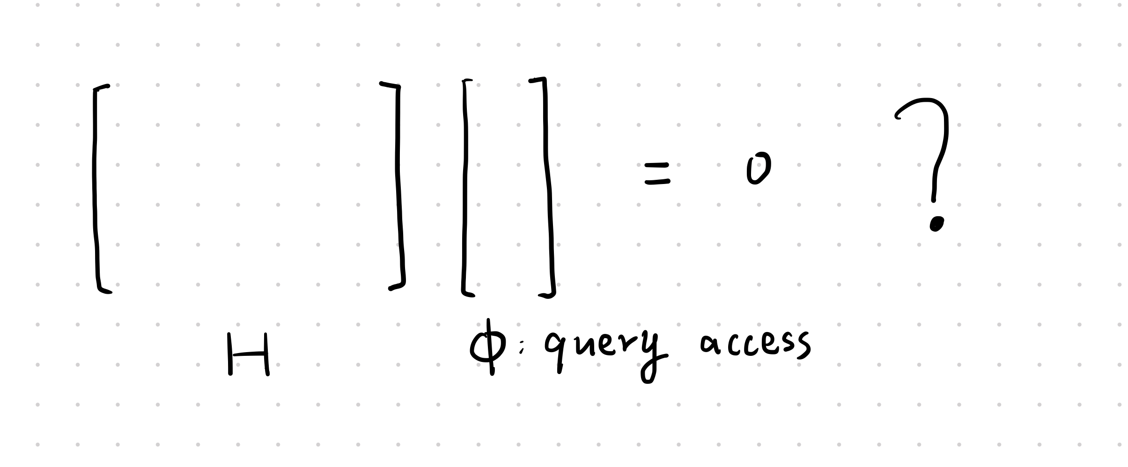
A direct try which failed
Goal: Test H$φ$=0 or $\left\langle φ\left|H\right|φ\right\rangle$>1/poly(n) using randomized classical algorithm.

Slide 27
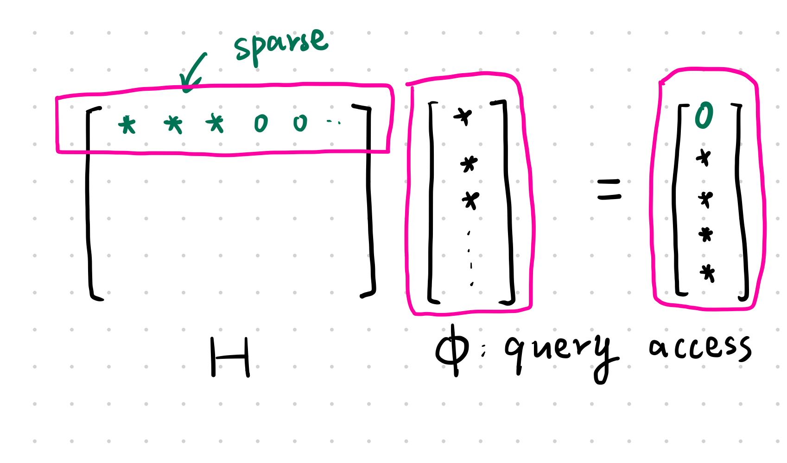
Goal: Test H$φ$=0 or $\left\langle φ\left|H\right|φ\right\rangle$>1/poly(n) using randomized classical algorithm.
Hint: Testing a row is easy
Sample row x of H, test <xH𝜙>=0?
No soundness:
H=Identity, No case.
𝜙=[1,0,0,….,0].
Accept w.p.~1.
Our algorithm: A weighted version of ‘direct try’.
Obtain weights from quantum Monte Carlo method.

Slide 28
Sketch for LHP with succinct gs is MA-Complete
Quantum Monte Carlo method
Stoquastic
work on different task
A “direct” algorithm
[BT10]
LHP with succinct ground state
Fixed Node
Hamiltonian
MA verification protocol
Doesn’t work.
Improve it by quantum monte Carlo!
[TLHVB+95]
Continuous time
Fixed Node MC
MA hardness
[BDOT06]
[BCGL22]

Slide 29
Quantum Monte Carlo method
Quantum Monte Carlo (here)
H $⇒$Markov Chain
$H$ stoquastic, $\left\langle x\left|H\right|y\right\rangle ≤0$ for $x≠y.$
Define transition matrix
Stoquastic
Given $H$,
Given query access to ground state $\left|ψ\right\rangle .$
[BT10]
Build a Markov Chain.
Invariant distribution
$$x∼{\left|\left\langle x | ψ\right\rangle \right|}^{2}$$
Fixed Node
Hamiltonian
$H$ general
Fixed Node F w.r.t $H,|ψ⟩$.
Stoquastic after easy basis change.
$λ\left(F\right)=λ(H)$.
[TLHVB+95]
Remark: Setting of QMC are different from us.
Sampling vs deciding $λ\left(H\right).$
Trusted vs adversary “ground state”.
Continuous time
Fixed Node MC
[BCGL22]

Slide 30
Quantum Monte Carlo method
Quantum Monte Carlo (here)
H $⇒$Markov Chain
$H$ stoquastic, $\left\langle x\left|H\right|y\right\rangle ≤0$ for $x≠y.$
Define transition matrix
Stoquastic
Given $H$,
Given query access to ground state $\left|ψ\right\rangle .$
[BT10]
Build a Markov Chain.
Invariant distribution
$$x∼{\left|\left\langle x | ψ\right\rangle \right|}^{2}$$
Fixed Node
Hamiltonian
$H$ general
Fixed Node F w.r.t $H,|ψ⟩$.
Stoquastic after easy basis change.
$λ\left(F\right)=λ(H)$.
Problem
|F| exponentially large.
$β$ exponentially small.
[TLHVB+95]
Remark: Setting of QMC are different from us.
Sampling vs deciding $λ\left(H\right).$
Trusted vs adversary “ground state”.
Continuous time
Fixed Node MC
[BCGL22]

Slide 31
Quantum Monte Carlo method
Quantum Monte Carlo (here)
H $⇒$Markov Chain
$H$ stoquastic, $\left\langle x\left|H\right|y\right\rangle ≤0$ for $x≠y.$
Define transition matrix
Stoquastic
Given $H$,
Given query access to ground state $\left|ψ\right\rangle .$
[BT10]
Build a Markov Chain.
Invariant distribution
$$x∼{\left|\left\langle x | ψ\right\rangle \right|}^{2}$$
Fixed Node
Hamiltonian
$H$ general
Fixed Node F w.r.t $H,|ψ⟩$.
Stoquastic after easy basis change.
$λ\left(F\right)=λ(H)$.
Problem
|F| exponentially large.
$β$ exponentially small.
[TLHVB+95]
Remark: Setting of QMC are different from us.
Sampling vs deciding $λ\left(H\right).$
Trusted vs adversary “ground state”.
Continuous time
Fixed Node MC
[BCGL22]

Slide 32
Outline
Continuous-time MC & Advantage
Continuous-time Fixed Node MC [BCGL22]
Our MA verification protocol
Summary

Slide 33
More details
Continuous-time MC vs Discrete-time MC
Discrete-time Markov Chain | Continuous-time Markov Chain
State $ξ\left(t\right),$ $t=1,2,…$ | State $ξ\left(t\right), t∈[0,1]$
$$ξ(t)$$
$$ξ(t)$$
t
t
$$x_{in}$$
$$x_{in}$$

Slide 34
More details
Continuous-time MC vs Discrete-time MC
Discrete-time Markov Chain | Continuous-time Markov Chain
State $ξ\left(t\right),$ $t=1,2,…$ | State $ξ\left(t\right), t∈[0,1]$
Transition matrix P
Transition probability $⟨y|P|x⟩$
$$ξ(t)$$
$$ξ(t)$$
t
t
$$x_{in}$$
$$y$$
$$x_{in}$$

Slide 35
More details
Continuous-time MC vs Discrete-time MC
Discrete-time Markov Chain | Continuous-time Markov Chain
State $ξ\left(t\right),$ $t=1,2,…$ | State $ξ\left(t\right), t∈[0,1]$
Transition matrix P | Generator $G$
Transition probability $⟨y|P|x⟩$ | Transition rate $⟨y|G|x⟩$
 | Transition probability in small time h
$$ξ(t)$$
$$ξ(t)$$
t
t
$$x_{in}$$
$$y$$
$$x_{in}$$
$$y$$
h
$$x_{in}$$

Slide 36
More details
Continuous-time MC vs Discrete-time MC
Discrete-time Markov Chain | Continuous-time Markov Chain
State $ξ\left(t\right),$ $t=1,2,…$ | State $ξ\left(t\right), t∈[0,1]$
Transition matrix P | Generator $G$
Transition probability $⟨y|P|x⟩$ | Transition rate $⟨y|G|x⟩$
$$\operatorname{Pr}\left(ξ\left(t\right)=y\right)=⟨y\left|P^{t}\right|x_{in}⟩$$ | $$\operatorname{Pr}\left(ξ\left(t\right)=y\right)=⟨y\left|e^{Gt}\right|x_{0}⟩$$
$$ξ(t)$$
$$ξ(t)$$
t
t
$$x_{in}$$
$$y$$
$$x_{in}$$
h

Slide 37
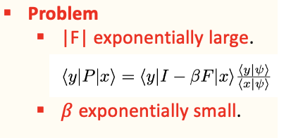
More details
Continuous-time MC vs Discrete-time MC
Discrete-time Markov Chain | Continuous-time Markov Chain
State $ξ\left(t\right),$ $t=1,2,…$ | State $ξ\left(t\right), t∈[0,1]$
Transition matrix P | Generator $G$
Transition probability $⟨y|P|x⟩$ | Transition rate $⟨y|G|x⟩$
$$\operatorname{Pr}\left(ξ\left(t\right)=y\right)=⟨y\left|P^{t}\right|x_{in}⟩$$ | $$\operatorname{Pr}\left(ξ\left(t\right)=y\right)=⟨y\left|e^{Gt}\right|x_{0}⟩$$
Fixed step size
$$ξ(t)$$
$$ξ(t)$$
t
t
$$x_{in}$$
$$Δτ$$
$$y$$
$$Δτ$$
$$x_{in}$$

Slide 38
More details
Continuous-time MC vs Discrete-time MC
Discrete-time Markov Chain | Continuous-time Markov Chain
State $ξ\left(t\right),$ $t=1,2,…$ | State $ξ\left(t\right), t∈[0,1]$
Transition matrix P | Generator $G$
Transition probability $⟨y|P|x⟩$ | Transition rate $⟨y|G|x⟩$
$$\operatorname{Pr}\left(ξ\left(t\right)=y\right)=⟨y\left|P^{t}\right|x_{in}⟩$$ | $$\operatorname{Pr}\left(ξ\left(t\right)=y\right)=⟨y\left|e^{Gt}\right|x_{0}⟩$$
Fixed step size | Varying step size!! [BCGL22]Do not need exponential small $β$
$$ξ(t)$$
$$ξ(t)$$
t
t
$$x_{in}$$
$$Δτ$$
$$y$$
$$Δτ$$
$$x_{in}$$
$$Δτ_{x}$$
$$y$$
$$Δτ_{y}$$

Slide 39
Continuous-time Fixed Node Monte Carlo method
Continuous-time Fixed Node Monte Carlo method [BCGL22]
Given H, access to exact ground state 𝜓.
Goal: Sample from ground state $x∼{\left|\left\langle x | ψ\right\rangle \right|}^{2}.$
Define Continuous-time Markov Chain with generator G
${ x∼\left|ψ_{x}\right|}^{2}$ is the invariant distribution of G.

Slide 40
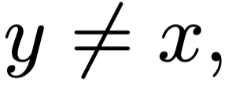
Continuous-time Fixed Node Monte Carlo method
Continuous-time Fixed Node Monte Carlo method [BCGL22]
Given H, access to exact ground state 𝜓.
Goal: Sample from ground state $x∼{\left|\left\langle x | ψ\right\rangle \right|}^{2}.$
Define Continuous-time Markov Chain with generator G
G is a legal generator:
${ x∼\left|ψ_{x}\right|}^{2}$ is the invariant distribution of G.

Slide 41
Further remark on setting differences between [BCGL22] and ours
[BCGL22] CTMC
Sampling ${ x∼\left|ψ_{x}\right|}^{2}$
$ψ$ is trusted ground state.
Exact ground state
Our protocol (simplified version)
Deciding $λ\left(H\right)$
$φ$ may be adversary.
Spectral gap
Unique ground state
good start string of CTMC
Promise gap
Adding checks in the CTMC
Viewed as weighted version of direct try

Slide 42
Our protocol
[BCGL22] CTMC
Sampling ${ x∼\left|ψ_{x}\right|}^{2}$
$ψ$ is trusted ground state.
Our protocol (simplified version)
Deciding $λ\left(H\right)$
$φ$ may be adversary.
Property: Suppose $φ$ is ground state and H$φ$=0, then G is always a legal generator.
In No case, illegal distribution
(1). $Δτ_{x}←$ exponential distribution with parameter $|\left\langle x\left|G\right|x\right\rangle |$.
Our protocol: Reject if illegal distribution.
Weighted version of the “direct check”.
(2). Jump to $y$ w.r.t embedded chain P.

Slide 43
Completeness and soundness
Completeness: [BCGL22] Require$φ$ to be the exact ground state, it constitutes the
Completeness of our verification protocol.
Soundness of our protocol comes
From two facts:
$\left(1\right) −λ\text{(}\text{F}\text{)}≤−λ$(H)= -1/poly [TLHVB+95]
(2) The accepting probability is smaller
than
Intuition of the soundness comes from
MA-verification protocol for stoquastic
Frustration-free Hamiltonian [BT06]
(1). $Δτ_{x}←$ exponential distribution with parameter $|\left\langle x\left|G\right|x\right\rangle |$.
(2). Jump to $y$ w.r.t embedded chain P.
Reject if not illegal distribution.

Slide 44
MA-hardness
Implied from proof in [BDOT06]
MA-hardness of stoquastic Hamiltonian
Proof sketch:
Begin with MA-complete question described by quantum circuit
V=R_{T}R_{T-1}…R_{1.}
Using Kitaev’s circuit-to-Hamiltonian reduction get a local Hamiltonian H s.t. H has low ground energy iff V accepts with high probability.
Moreover, the ground state is of form: succinct

Slide 45
Summary: Extreme strong guided states help to resolve sign problem.
LHP: Decide λ(H)≤a or λ(H)≥b, b-a>1/poly(n)
Open Problem: Strong guided states help to resolve sign problem.
Stoquastic
General Hamiltonian
Sensitive to errors.
MA-complete
[BT10] [Liu20]
MA-complete
Our result
Succinct ground State
MA-complete
[Bra14]
MA-complete
???
Strong guided State
A robust Quantum Monte Carlo method!
Meaningful method
General H → stoquastic
New Fixed node QMC

Slide 46
Summary: Extreme strong guided states help to resolve sign problem.
LHP: Decide λ(H)≤a or λ(H)≥b, b-a>1/poly(n)
Open Problem: Strong guided states help to resolve sign problem.
Stoquastic
General Hamiltonian
MA-complete
[BT10] [Liu20]
MA-complete
Our result
Succinct ground State
MA-complete
[Bra14]
MA-complete
???
Strong guided State
Open Problem:More quantum algorithm for Local Hamiltonian problem?

Slide 47
Summary: Extreme strong guided states help to resolve sign problem.
LHP: Decide λ(H)≤a or λ(H)≥b, b-a>1/poly(n)
Open Problem: Strong guided states help to resolve sign problem.
Stoquastic
General Hamiltonian
MA-complete
[BT10] [Liu20]
MA-complete
Our result
Succinct ground State
MA-complete
[Bra14]
MA-complete
???
Strong guided State
Open Problem:More quantum algorithm for Local Hamiltonian problem? Thanks for listening. Questions ?

Slide 48
Appendix
Gillespie’s algorithm

Slide 49
Efficient simulation via Gillespie’s algorithm
Why continuous-time MC? Circumvent the exponential |F| Problem?
|G| is still exponential large. But
Theorem [BCGL22]: Efficient simulation of CTMC via Gillespie’s algorithm.
$$ξ(s)$$
Generate $ξ: \left[0,t\right]→{\left\{0,1\right\}}^{n}$
0
t
$$x_{in}$$
$$Δτ_{x}$$
By Embedded Chain + Waiting time.
Embedded Chain P
(1). $Δτ_{x}←$ exponential distribution with parameter $|\left\langle x\left|G\right|x\right\rangle |$.
(2).

Slide 50
Efficient simulation via Gillespie’s algorithm
Why continuous-time MC? Circumvent the exponential |F| Problem?
|G| is still exponential large. But
Theorem [BCGL22]: Efficient simulation of CTMC via Gillespie’s algorithm.
$$ξ(s)$$
Generate $ξ: \left[0,t\right]→{\left\{0,1\right\}}^{n}$
0
t
$$x_{in}$$
$$Δτ_{x}$$
$$y$$
$$Δτ_{y}$$
By Embedded Chain + Waiting time.
Embedded Chain P
(1). $Δτ_{x}←$ exponential distribution with parameter $|\left\langle x\left|G\right|x\right\rangle |$.
(2). Jump to $y$ w.r.t embedded chain P.

Slide 51
Efficient simulation via Gillespie’s algorithm
$$ξ(s)$$
0
t
$$x_{in}$$
$$Δτ_{x}$$
$$y$$
$$Δτ_{y}$$
Problems for CTMC: Infinitely transitions in finite time.
$$\frac{1}{2}+\frac{1}{2^{2}}+…<t$$
Theorem [BCGL22]: With high probability, in [0,t] the CTMC only transits for $O\left(t \left\langle ψ\left|F_{od}\right|ψ\right\rangle \right)=poly(n)$ times

