Slide 1
How Hamiltonian Complexity differs from quantum chemistry
Do complexity results prove or disprove quantum advantage?
Jiaqing Jiang
Simons Institute
July 10, 2025
Notes:
Martin Head-Gordon Computational quantum chemistry: Classical gaps, quantum opportunities, open questions

Slide 2
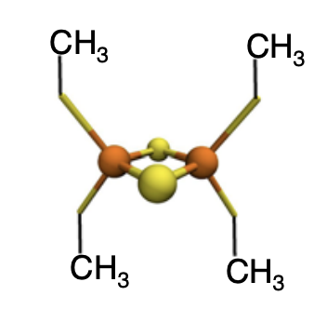
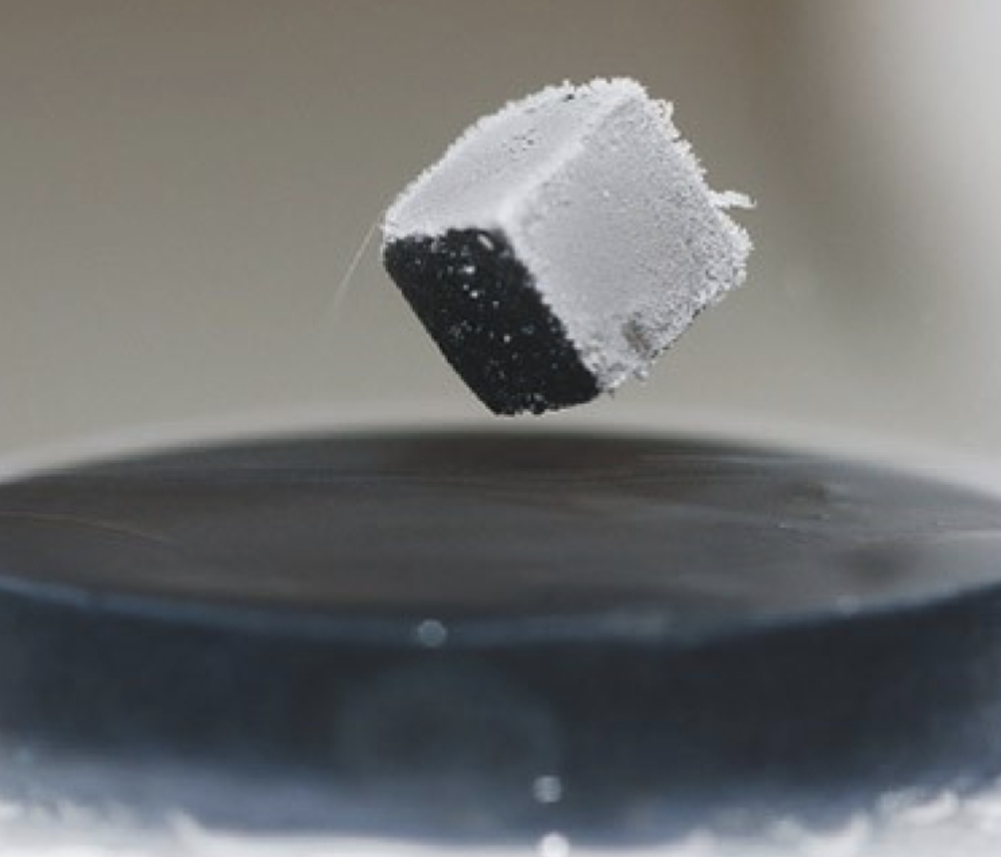
Quantum Many-body system and ground energy
Static properties of a molecules and materials
Ground energy: The lowest possible energy that the system can have.
[2Fe-2S] figure
from [Lee et al. 2023]
[Lee … Chan 2003] Nat. Comms. 14, 1952 (2023)
Notes:
to begin with, let’s first give some background information. Let’s first talk about the key task in this talk. Quantum; molecule metal cluster

Slide 3
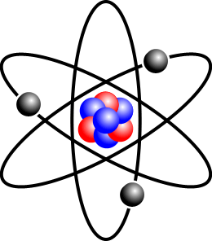
Ground energy estimation
n-qubit local Hamiltonian
GEE: estimate λ(H)
minimum eigenvalue
$2^{n}$-size
constant-qubit
ground state minimum eigenstate
ground energy λ(H) minimum eigenvalue

Slide 4
Ground energy estimation
n-qubit local Hamiltonian
GEE: estimate λ(H)
minimum eigenvalue
$2^{n}$-size
constant-qubit

Slide 5
Ground energy estimation
n-mode local fermionic Hamiltonian (4-local)
Complex number
highly non-local
$$\left[\begin{matrix}1 & 0 \\ 0 & −1\end{matrix}\right]$$
$$\left[\begin{matrix}0 & 0 \\ 1 & 0\end{matrix}\right]$$

Slide 6
Complexity of ground energy estimation (GEE)
A quantum advantage perspective
Is it possible for quantum computer to solve GEE?
QMA-complete
When can quantum computer solve GEE?
BQP-complete
When can classical computer solve GEE?
BPP-complete
How does those results differ from problems in quantum chemistry
(different model, different assumption, different interpretation)

Slide 7
Section I: Can quantum computer solve GEE?
GEE is quantumly hard in worst case
but no hardness result for natural Hamiltonians

Slide 8
GEE is quantumly hard in worst case
[KKR06] Local Hamiltonian Problem is QMA-Complete.
Decision version of GEE
Given n-qubit local Hamiltonian H,
decide whether $λ$(H)>b or $λ$(H)<a
Precision b-a=1/poly(n)
Quantum analogy of NP
Problems which can be verified efficiently by quantum computer
[KKR06] SIAM J. Comput. 35, 1070 (2006)

Slide 9
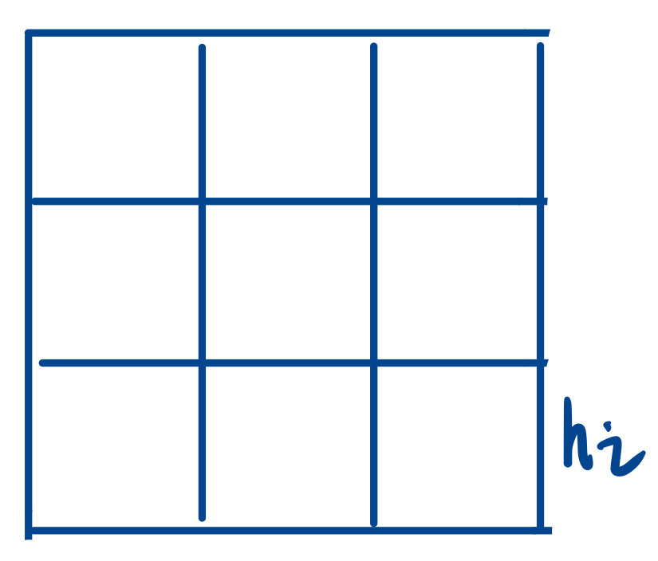
GEE is quantumly hard in worst case
[KKR06] Local Hamiltonian Problem is QMA-Complete.
Hardness even holds for special
$$H= h_{1}+ …+h_{m}$$
Do we believe quantum computer can solve GEE?
Geometrically local [OT05, AGIK07].
1D translationally-invariant
[GI09]
[OT05] Quantum Inf. Comput. 8, 900 (2008);
[AGIK07] Commun. Math. Phys. 287, 41 (2009);
[GI09] FOCS 2009, arxiv: 0905.2419
Notes:
You may ask whether specific structure will help to decrease the complexity, unfortunately no. QMA-hardness result hold for even xxx, and xx. From those results and many other similar results, it seems no hope for quantum advantage in quantum chemistry.

Slide 10
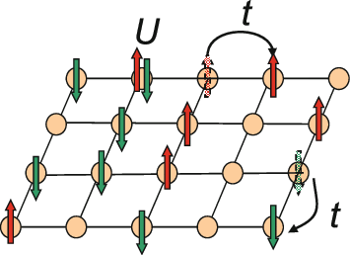
Fermi-Hubbard model
QMA-complete but no hardness result for the model in chemistry
Ground state/ground energy is used to
Insulator, conductor, super-conducting...
Remark: ground energy w.r.t fixed particle number;
Variants of this model
Notes:
Fermi-hubbard model

Slide 11
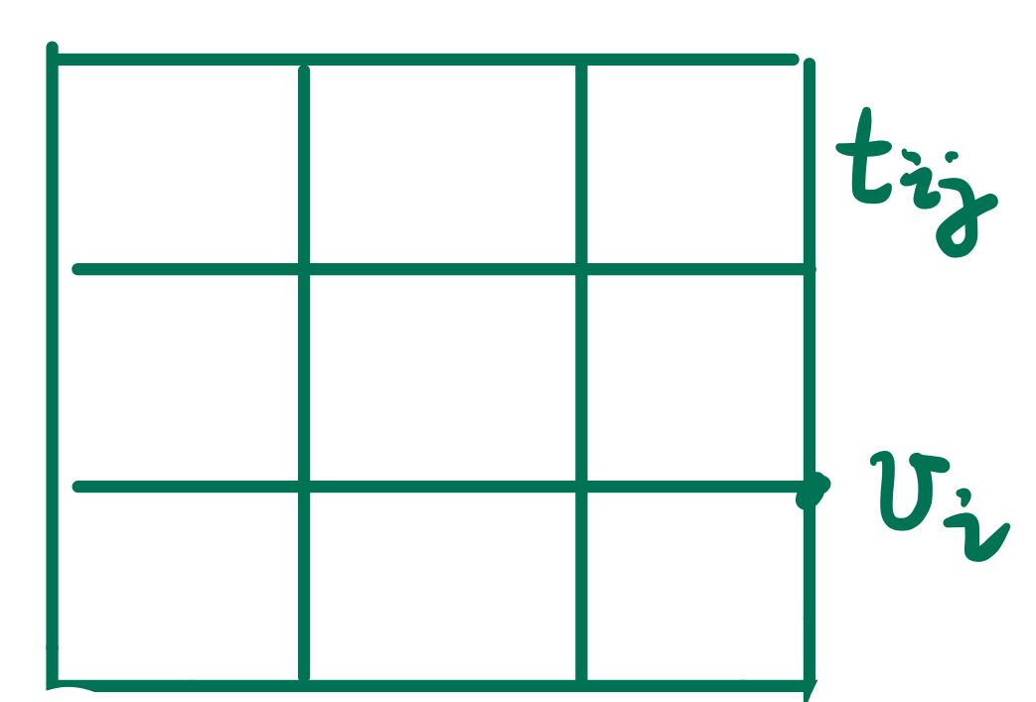
GEE of Fermi-Hubbard model becomes QMA-complete if
generic graph
[GIWF21]
Not TI [SV09]
[GIWF21] arxiv:2103.08215
[SV09] Nat. Phys. 5, 732 (2009)
Notes:
p.s. from [GIWF21] “Schuch and Verstraete [20] show as an intermediate result that the Fermi-Hubbard Hamiltonian on a 2D lattice with a site-specific magnetic field is QMA-hard;”

Slide 12
Fermi-Hubbard model in Chemistry
Key features: 2D + translationally-invariant
No QMA-hardness result!
Seems classically hard in the intermediate coupling region
Survey of numerical algorithms: arxiv:2104.00064
Notes:
As

Slide 13
Summary of Sec I
Open problem: complexity of GEE? QMA vs BQP vs BPP?
No hardness result; challenging for classical algorithms;
Room for quantum advantage

Slide 14
Section II: When can quantum computer solve GEE?
Under some assumptions GEE is quantumly easy
but chemists raise questions for the assumption

Slide 15
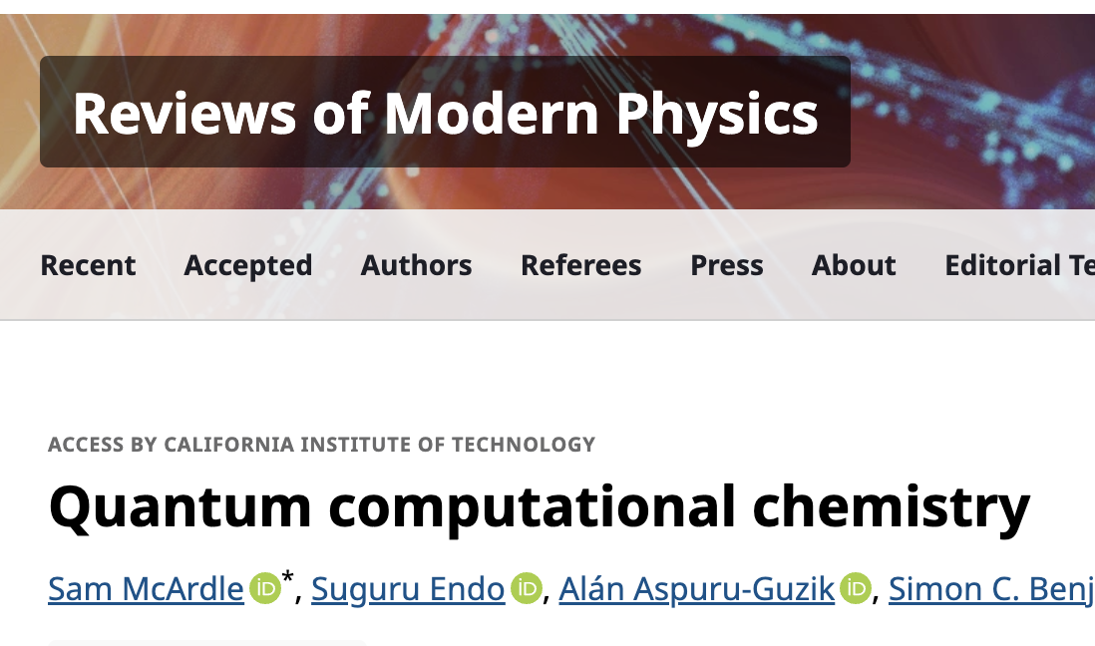
GEE with guided states
$$+$$
Quantum Phase Estimation
Guided state
1/poly overlap with ground state
efficient to prepare
Input: ground state
Output: $λ(H)$
Notes:
The most commonly used assumption is assuming we magically have a guided state

Slide 16
GEE with guided states
$$+$$
Quantum Phase Estimation
Guided state
1/poly overlap with ground state
efficient to prepare
Input: ground state
Output: $λ(H)$
Quantum advantage (??): With guided state, GEE becomes quantumly easy, but maybe also classically easy?
Guided state is obtained from classical algorithms
Notes:
For theorists, we mainly care about whether there are quantum advantage. Since we already have a efficient quantum algorithm, the main problem is whether there are efficeint classical algorithms in this setting. The main concern comes from the guided state itself

Slide 17
Quantum advantage (??) for GEE with guided state
BQP-complete result
Chemists' question
Further complexity result on dequantization

Slide 18
GEE with guided state [GLG22]
Input: (H, $u$, $ε$)
k-local Hamiltonian H=H₁ +…+H_{m} acting on n-qubits;
Classical query and sample access to a vector $u∈C^{2n}$
Precision parameter $ε$
Promise: $u$ is a guided state
Output: estimate $λ(H)$ within $mε$ precision
[GLG22] STOC 2022, arxiv:2111.09079

Slide 19
Quantum advantage for GEE with guided state
is achieving higher precision
[GLG22]
BQP-complete
BPP
estimating $λ\left(H\right)$
to $mε$ precision
$ε=$1/poly
$ε=$constant
Conditioned on BQP$≠$BPP, quantum computer can estimate ground energy to a higher precision!
[GLG22] STOC 2022, arxiv:2111.09079

Slide 20
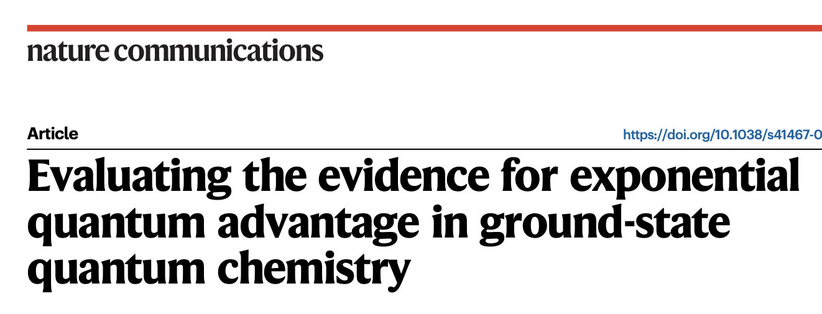
Chemist raise question on the assumptions
[Lee…Chan 2023] do we model guided states correctly?
[Lee…chan. 2003] Nat. Comms. 14, 1952 (2023)

Slide 21
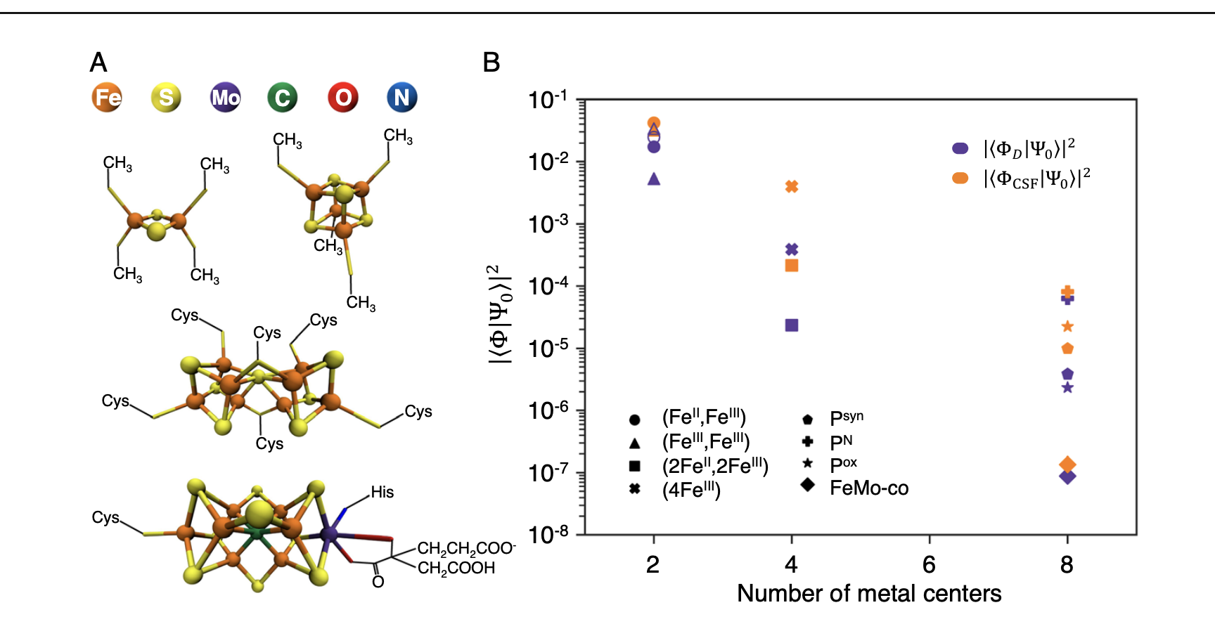
Chemist raise question on the assumptions
[Lee…Chan 2023] Numerically check the overlap between guided states and ground state

Slide 22
Chemist raise question on the assumptions
[Lee…Chan 2023] Numerically check the overlap between guided states and ground state
For hard Hamiltonian, classical algorithms might not find guided state
If the classical algorithms can find guided states, then the guided state might be “stronger”
?
Previous BQP-hardness may not hold.
With strong guided state, will GEE be classically easy?

Slide 23
Definition of strong guided state
guided state
1/poly overlap with ground state
strong guided state
No standard definition
entry-wise 1/poly overlap with ground state
classical query access
With strong guided state, will GEE be classically easy?
Notes:
There is no standard definition of strong guided state

Slide 24
Classical algorithm (?) for GEE with strong guided state
Why GEE is classically hard: a refined understanding
(1) H is exponential-size
(2) Sign problem
In practice SAT solver works well.
Quantum mechanics
[Bra14] Randomized algorithm almost works for sign-free Hamiltonian.
VS
Probability theory
[J25] strong guided state might help to resolve the sign problem
Classical algorithms are more powerful than you might think!

Slide 25
Classical algorithm (?) for GEE with strong guided state
sign-free Hamiltonian + strong guided state
[Bra14]
$H$ stoquastic, $\left\langle x\left|H\right|y\right\rangle ≤0$ for $x≠y.$
$I−βH$ is a non-negative matrix, can be connected to Markov chain
[Bra14] Quantum Inf. Comput. 15, 1122 (2015)
Notes:
In fact it is possible to design classical algorithm at least for sign free Hamiltonian

Slide 26
Classical algorithm (?) for GEE with strong guided state
sign-free Hamiltonian + strong guided state
[Bra14]
Efficient classical algorithm for GEE (*decision version)
Projection Monte Carlo algorithm
$η$strong guided state (classical query access)
$$x$$
$$y$$
Warm start of the Markov chain
Some other classical guiding information
[Bra14] Quantum Inf. Comput. 15, 1122 (2015)
Notes:
This connection to Markov chain allow you to define an efficient classical algorithm for GEE

Slide 27
A weaker formulation
View strong guided state as witness instead of input
LHP with strong guided states (H,a,b)
H = H₁ + H₂ + … + H_{m}
Yes: $λ$(H)$≤a$, promised that there exists a strong guided state $ψ$.
No: $λ$(H)$≥b$?
b-a = 1/poly
Conjecture: LHP with strong guided state is in MA.
[Bra14] The conjecture is true for sign-free Hamiltonian
Notes:
A weaker & necessary version, Treat guided state as witness instead instead of a given input

Slide 28
Classical algorithm (?) for GEE with strong guided state
sign-free Hamiltonian + strong guided state
[Bra14] MA-complete

Slide 29
Classical algorithm (?) for GEE with strong guided state
sign-free Hamiltonian + strong guided state
[Bra14] MA-complete
Can we circumvent the sign problem ?
general Hamiltonian + strong guided state
(???) MA-complete (???)
Evidence that strong guided state might help to resolve the sign problem
Notes:
What’s this warm start

Slide 30
A weaker & necessary problem
Poly-size classical circuit to compute amplitude (classical query access)
$$A\left(x\right)=c⋅⟨x|ψ⟩$$
Note that there is no sample access,
only query access.
“Extremely strong guided state”
“Extremely strong guided state”
LHP with succinct ground states
H = H₁ + H₂ + … + H_{m}
b-a>1/poly(n)
Yes: $λ$(H)<a, there exists a succinct ground state.
No: $λ$(H)>b?
[J25]: LHP with succinct ground state is MA-Complete.
[J25] PRX Quantum 6, 020312 (2025)
Notes:
A weaker & necessary problem
PRX Quantum 6, 020312 (2025)

Slide 31
Relationship to the conjecture
[J25]: LHP with succinct ground state is MA-Complete.
Necessary condition
Conjecture: LHP with strong guided state is MA-complete.
Even for LHP with succinct ground state, previously MA result is only known for sign-free Hamiltonian [BT10] [Liu20]
[J25] demonstrate a possible way to resolve sign problem.
Notes:
Necessary condition; previous result only known for sign-free Hamiltonian; we demonstrate a way to circumvent the sign problem

Slide 32
Fixed node quantum Monte Carlo method
Transform general Hamiltonian to stoquastic Hamiltonian
FNQMC [TLHVB+95] [BCGL22]
$$H, |η⟩$$
$F^{H,η}$, stoquastic
$λ\left(F\right)≥ λ(H)$, = if $|η⟩$ is the ground state
||F|| exponentially large
Continuous-time FNQMC [BCGL22]:
Markov chain but with varying step-size!
[TLHVB+95] Phys. Rev. B 51, 13039 (1995); [BCGL22] Quantum 7, 1173 (2023)

Slide 33
Techniques to resolve the sign problem
Stoquastic
[BT10]
Fixed Node
Hamiltonian
[TLHVB+95]
Continuous time
Fixed Node MC
[BCGL22]
Notes:
The message I want to give is quantum advantage is subtle than just saying the problem is hard since H is of exponential size. An example of techniques to circumvent sign problem; used in the MA result

Slide 34
Techniques to resolve the sign problem (general H -> stoquastic)
Quantum Monte Carlo (here)
H $⇒$Markov Chain
$H$ stoquastic, $\left\langle x\left|H\right|y\right\rangle ≤0$ for $x≠y.$
Define transition matrix
Stoquastic
Given $H$,
Given query access to ground state $\left|ψ\right\rangle .$
[BT10]
Build a Markov Chain.
Invariant distribution
$$x∼{\left|\left\langle x | ψ\right\rangle \right|}^{2}$$
Fixed Node
Hamiltonian
$H$ general
Fixed Node F w.r.t $H,|ψ⟩$.
Stoquastic after easy basis change.
$λ\left(F\right)=λ(H)$.
[TLHVB+95]
Continuous time
Fixed Node MC
[BCGL22]

Slide 35
Techniques to resolve the sign problem (general H -> stoquastic)
Quantum Monte Carlo (here)
H $⇒$Markov Chain
$H$ stoquastic, $\left\langle x\left|H\right|y\right\rangle ≤0$ for $x≠y.$
Define transition matrix
Stoquastic
Given $H$,
Given query access to ground state $\left|ψ\right\rangle .$
[BT10]
Build a Markov Chain.
Invariant distribution
$$x∼{\left|\left\langle x | ψ\right\rangle \right|}^{2}$$
Fixed Node
Hamiltonian
$H$ general
Fixed Node F w.r.t $H,|ψ⟩$.
Stoquastic after easy basis change.
$λ\left(F\right)=λ(H)$.
[TLHVB+95]
Continuous time
Fixed Node MC
[BCGL22]

Slide 36
Techniques to resolve the sign problem (general H -> stoquastic)
Quantum Monte Carlo (here)
H $⇒$Markov Chain
$H$ stoquastic, $\left\langle x\left|H\right|y\right\rangle ≤0$ for $x≠y.$
Define transition matrix
Stoquastic
Given $H$,
Given query access to ground state $\left|ψ\right\rangle .$
[BT10]
Build a Markov Chain.
Invariant distribution
$$x∼{\left|\left\langle x | ψ\right\rangle \right|}^{2}$$
Fixed Node
Hamiltonian
$H$ general
Fixed Node F w.r.t $H,|ψ⟩$.
Stoquastic after easy basis change.
$λ\left(F\right)=λ(H)$.
Problem
|F| exponentially large.
$β$ exponentially small.
[TLHVB+95]
Continuous time
Fixed Node MC
[BCGL22]

Slide 37
Techniques to resolve the sign problem (general H -> stoquastic)
Quantum Monte Carlo (here)
H $⇒$Markov Chain
$H$ stoquastic, $\left\langle x\left|H\right|y\right\rangle ≤0$ for $x≠y.$
Define transition matrix
Stoquastic
Given $H$,
Given query access to ground state $\left|ψ\right\rangle .$
[BT10]
Build a Markov Chain.
Invariant distribution
$$x∼{\left|\left\langle x | ψ\right\rangle \right|}^{2}$$
Fixed Node
Hamiltonian
$H$ general
Fixed Node F w.r.t $H,|ψ⟩$.
Stoquastic after easy basis change.
$λ\left(F\right)=λ(H)$.
Problem
|F| exponentially large.
$β$ exponentially small.
[TLHVB+95]
Continuous time
Fixed Node MC
[BCGL22]

Slide 38
Summary of Sec II: quantum advantage w.r.t guided state
Quantum advantage is achieving high precision, w.r.t standard guided state
Chemists raised question on the definition of guided state, which potentially invalidate the quantum advantage from BQP-complete result
Evidence of possible classical algorithms with strong guided state
Conjecture: LHP with strong guided state is MA-complete.
Notes:
Chemists raised question on the definition of guided state which potentially invalidate the quantum advantage

Slide 39
Section III: When can classical computer solve GEE?
Few results, but in BPP does not mean no room for quantum advantage
Notes:
I feel this title is strange

Slide 40
[Chan24]
[Chan24] Faraday Discuss. 254, 11 (2024)

Slide 41
[Chan24] Empirical observations suggest that for many systems, classical quantum chemistry methods satisfy the classical heuristic cost conjecture
Find an appropriate reference state
(search problem)
$poly\left(n\right)poly(\frac{1}{ϵ}$)
Potential Quantum advantage is to improve the dependence on precision
For some systems $C_{refinement}$ might be $poly\left(n\right)exp(\frac{1}{ϵ}$), room for exponential quantum advantage
[Chan24] Faraday Discuss. 254, 11 (2024)
Notes:
The paragragh around eq 26

Slide 42
Four possible way of quantum advantage
Classical cost
Quantum speedup
advantage
likelihood
$$R×poly\left(n\right)poly(\frac{1}{ϵ})$$
poly
common
refinement
$$R×poly\left(n\right)exp(\frac{1}{ϵ})$$
exp
possible
refinement
$$exp⁡(n)×C$$
State prep.
poly
common
$$exp⁡(n)×C$$
State prep.
exp
unlikely
Table 6 of [Chan24]

Slide 43
Summary: How Hamiltonian Complexity differ from quantum chemistry
GEE is quantumly hard in worst-case but no hardness result for natural Hamiltonian (e.g. Fermi-Hubbard model)
With practical guided states, GEE becomes quantumly easy but still unclear whether it is also classically easy
Even if GEE is in BPP does not mean no room for quantum advantage
Open problems:
Quantum algorithm of Fermion-Hubbard model (2D+TI)
Complexity of GEE with strong guided state
Notes:
Open problems: (1) Hardness of fermion-Hubbard model
(2) GEE with strong guided state
Advise work more on fermionic system?

Slide 44
Appendix: Open problems
Notes:
I feel this title is strange

Slide 45
Fermi-Hubbard model
No hardness result; hard for classical numerics;
Room for quantum advantage
Open problem: QMA vs BQP vs BPP?

Slide 46
GEE with strong guided state
Entry-wise 1/poly overlap with ground state
Classical query access
LHP with strong guided states
H = H₁ + H₂ + … + H_{m}
Yes: $λ$(H)$≤a$, there exists a strong guided state $ψ$.
No: $λ$(H)$≥b$?
b-a = 1/poly
Conjecture: LHP with strong guided state is in MA.
[J25]: LHP with succinct ground state is MA-Complete.
Notes:
A weaker & necessary version, Treat guided state as witness instead instead of a given input

